Slide 1
Google File System

Slide 2
Learning Objectives
State the origin of the Google File System and the application motivation that inspired its design and development.
Define the Google File System’s unique platform characteristics and their role.
Describe Google File System’s design criteria and its resultant platform architecture.
Describe Google File System’s consistency model.
Notes:
Students may not know exactly what is meant by globalization or may have an incomplete understanding of the term. You might ask students what they think it means. Potential answers could include: reduction of economic and cultural advantages of developed countries, increased number of companies with operations in multiple countries worldwide, and increased reliance on imports and exports of goods (and jobs). Globalization will be discussed in later slides as well.

Slide 3
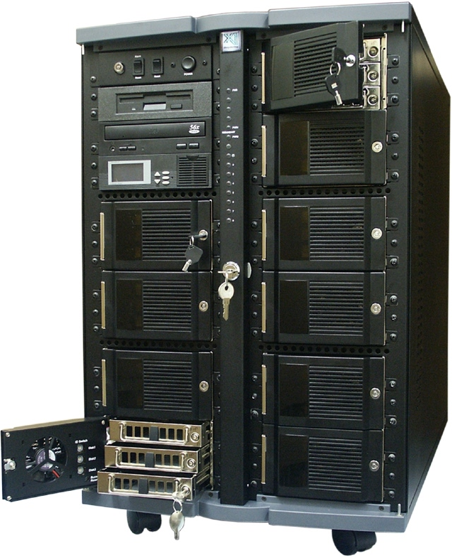
Motivating Application: Search
Crawl the whole web
Store it all on
“one big disk”
Process users’ searches on “one big CPU”
$$$$$
Doesn’t scale
Figure 1-1: One BIG Disk

Slide 4
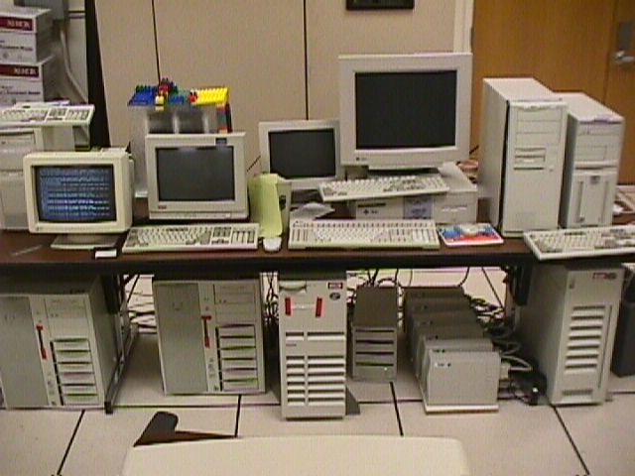
Motivating Application: Search
Figure 1-2: Lots of Cheap PCs

Slide 5
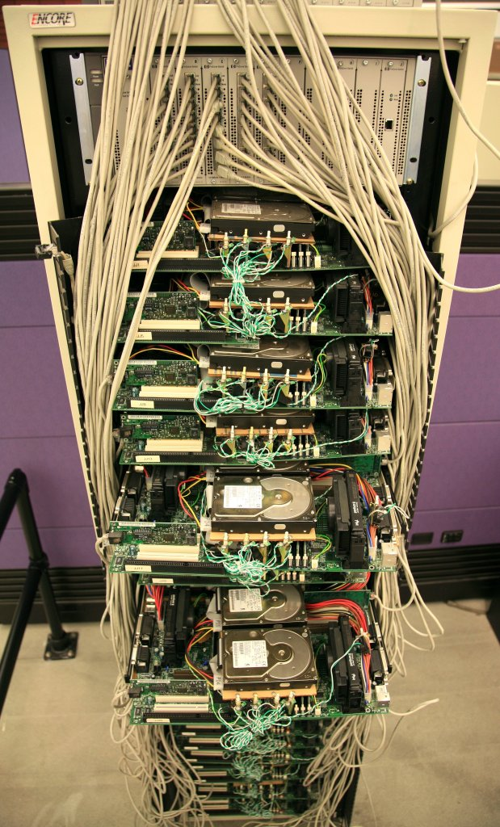
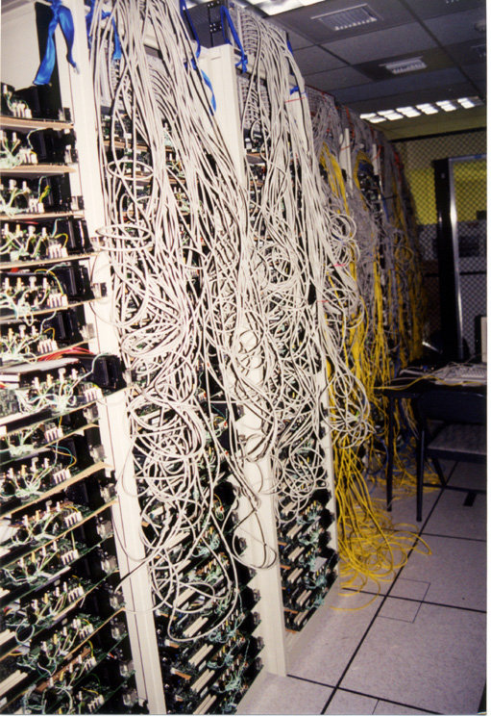
Google Platform Characteristics…
Figure 1-3: Lots of Cheap PCs

Slide 6
Background
Search Eg. : “TO BE OR NOT TO BE”
Use MapReduce to count all occurrences of words in a set of Web documents.
  "map“: tallying all occurrences of each word on each page -not bothering to add them at this stage, just ticking off records for each one like hash marks on a sheet of scratch paper.
  reduce function to do the math i.e. take the intermediate results, and produce a count for the number of times each word occurs on each page.
Kind of calc. Google performs ad infinitum. Invests heavily in a statistical computing, not just for search but for solving other problems like automatic translation between human languages.

Slide 7
Background…
multi-billion dollar company. It's one of the big power players on the WWW and beyond.
relies on a distributed computing system to provide users with the infrastructure they need to access, create and alter data.
Does Google buy state-of-the-art computers & servers to keep things running smoothly?

Slide 8
Background…
machines that power Google's operations aren't cutting-edge power computers with lots of bells and whistles.
relatively inexpensive machines running on Linux operating system.
How can one of the most influential companies on the Web rely on cheap hardware?

Slide 9
Background…
due to the Google File System (GFS), which capitalizes on the strengths of off-the-shelf servers while compensating for any hardware weaknesses.
it's all in the DESIGN! Proprietary!
GFS is enhanced for Google's core data storage and usage needs (primarily the search engine), which can generate enormous amounts of data that needs to be retained.
grew out of an earlier Google effort, "BigFiles", developed by Larry Page & Sergey Brin in the early days of Google.

Slide 10
Google Platform Characteristics…
Lots of cheap PCs, each with disk and CPU.
  High aggregate storage capacity
  Spread search processing across many CPUs.
100s to 1000s of PCs in each cluster.
Many modes of failure for each PC:
  App bugs, OS bugs
  Human error
  Disk failure, memory failure, net failure, power supply failure
  Connector failure etc.
Monitoring, fault tolerance, auto-recovery essential – autonomic computing?

Slide 11
Google File System: Design Criteria
Detect, tolerate, recover from failures automatically
Large files, >= 100 MB in size
Large, streaming reads (>= 1 MB in size)
  Read once
Large, sequential writes that append
  Write once
Concurrent appends by multiple clients (e.g. producer-consumer queues)
  Want atomicity for appends without synchronization overhead among clients.

Slide 12
GFS: Architecture
One Master Server (state replicated on backups).
Many Chunk Servers (100s – 1000s).
  Spread across racks; intra-rack b/w greater than inter-rack.
  Chunk: 64 MB portion of file, identified by 64-bit, globally unique ID.
Many clients accessing same and different files stored on same cluster.

Slide 13
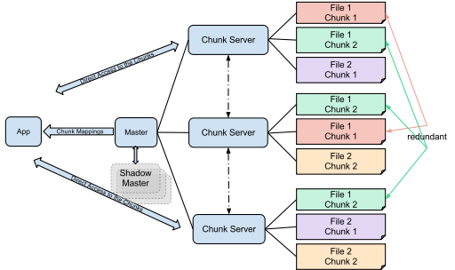
GFS: Architecture…
Figure 1-4: GFS Architecture

Slide 14
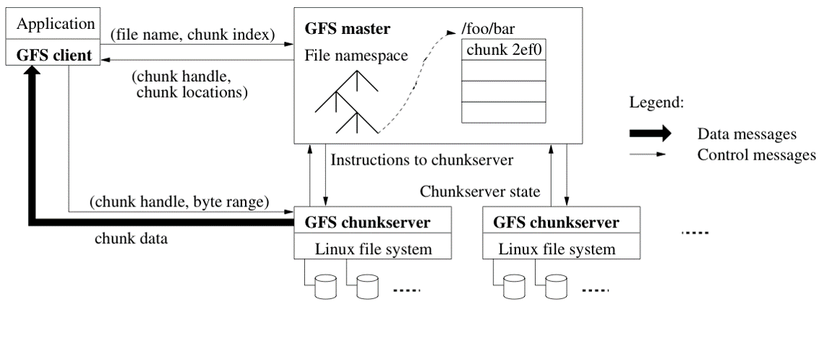
GFS: Architecture…
Figure 1-5: GFS Architecture

Slide 15
GFS: Architecture…
Google organizes the GFS into clusters of computers. A cluster is simply a network of computers.
Each cluster might contain hundreds or even thousands of machines.
Within GFS clusters there are three kinds of entities: Clients, Master Servers and Chunkservers.
Client: any entity that makes a file request. Requests can range from retrieving and manipulating existing files to creating new files on the system; can be other computers or computer applications; the ‘customers’ of the GFS.

Slide 16
GFS: Architecture…
Master: acts as the coordinator for the cluster. The master's duties include:
  maintaining an operation log, which keeps track of the activities of the master's cluster. The operation log helps keep service interruptions to a minimum i.e. if the master server crashes, a replacement server that has monitored the operation log can take its place.
  keeping track of metadata, which is the information that describes chunks. The metadata ‘tells’ the master server to which files the chunks belong and where they fit within the overall file.
  Upon startup, the Master polls all Chunkservers in its cluster. The Chunkservers respond by ‘telling’ the Master Server the contents of their inventories. From that moment on, the Master keeps track of the location of chunks within the cluster.

Slide 17
GFS: Architecture…
Chunkservers: the ‘workhorses’ of the GFS.
responsible for storing the 64-MB file chunks.
don't send chunks to the master server. Instead, they send requested chunks directly to the Client.
GFS copies every chunk multiple times and stores it on different Chunkservers. Each copy is called a replica.
By default, the GFS makes three replicas per chunk, but users can change the setting and make more or fewer replicas if so desired.

Slide 18
Master Server
Holds all metadata:
  Namespace (directory hierarchy)
  Access control information (per-file)
  Mapping from files to chunks
  Current locations of chunks (Chunkservers)
Delegates consistency management
Garbage collects orphaned chunks
Migrates chunks between Chunkservers.
Holds all metadata in RAM; very fast operations on file system metadata.

Slide 19
Chunkserver
Stores 64 MB file chunks on local disk using standard Linux filesystem, each with version number and checksum.
Read/write requests specify chunk handle and byte range.
Chunks replicated on configurable number of Chunkservers (default: 3).
No caching of file data (beyond standard Linux buffer cache).

Slide 20
Client
Issues control (metadata) requests to master server.
Issues data requests directly to Chunkservers.
Caches metadata.
Does no caching of data:
  No consistency difficulties among clients.
  Streaming reads (read once) and append writes (write once) don’t benefit much from caching at client.

Slide 21
Client API
Not a filesystem in the traditional sense:
  Not Portable Operating System Interface (POSIX) compliant.
  Does not use kernel VFS interface.
  Library that apps can link in for storage access.
API:
  open, delete, read, write (as expected).
  snapshot: quickly create copy of file.
  append: at least once, possibly with gaps and/or inconsistencies among clients.

Slide 22
GFS API: Client Read
Client sends Master:
  read(file name, chunk index)
Master’s reply:
  chunk ID, chunk version number, locations of replicas.
Client sends “closest” Chunkserver w/replica:
  read(chunk ID, byte range)
  “Closest” determined by IP address on simple rack-based network topology.
Chunkserver replies Client directly with data.

Slide 23
GFS API: Client Write
Some Chunkserver is primary for each chunk:
  Master grants lease to primary (typically for 60 sec.)
  Leases renewed using periodic ‘heartbeat’ messages between Master and Chunkservers.
Client asks Master for primary and secondary replicas for each chunk.
Client sends data directly to replicas in daisy chain:
  Pipelined: each replica forwards as it receives.
  Takes advantage of full-duplex Ethernet links.

Slide 24
API: Client Write…
ALL replicas acknowledge data write to client.
Client sends write request to primary.
Primary assigns serial number to write request, providing ordering.
Primary forwards write request with same serial number to secondaries.
Secondaries ALL reply to primary after completing write.
Primary replies to Client.

Slide 25
API: Client Write…
1-2: client obtains replica locations and identity of primary replica
3: client pushes data to replicas (stored in LRU buffer by chunk servers holding replicas).
4: client issues update request to primary
5: primary forwards/performs write request
6: primary receives replies from replicas
7: primary replies to client acknowledge data write to client.

Slide 26
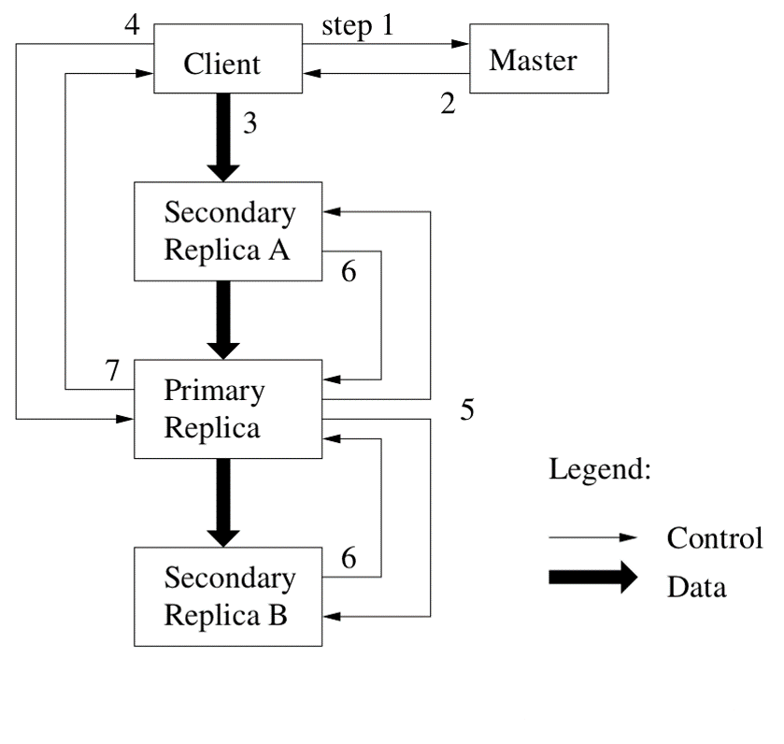
API: Client Write…
Figure 1-6: Write Control & Dataflow

Slide 27
API: Client Record Append…
Google uses large files as queues between multiple producers and consumers.
Same control flow as for writes, except…
  Client pushes data to replicas of last chunk of file.
  Client sends request to primary.
Common case: request fits in current last chunk:
  Primary appends data to own replica.
  Primary tells secondaries to do same at same byte offset in theirs.
  Primary replies with success to client.

Slide 28
API: Client Record Append…
When data won’t fit in last chunk:
  Primary fills current chunk with padding
  Primary instructs other replicas to do same
  Primary replies to client, “retry on next chunk”.
If record append fails at any replica, Client retries operation:
  So replicas of same chunk may contain different data - even duplicates of all or part of record data.
What guarantee does GFS provide on success?
  Data written at least once in atomic unit.

Slide 29
GFS: Consistency Model
Changes to namespace (i.e. metadata) are all atomic in nature:
  Done by single Master Server!
  Master uses log to define global total order of namespace -changing operations.

Slide 30
GFS: Consistency Model…
Changes to data are ordered as chosen by a primary;
  All replicas will be consistent
  But multiple writes from the same client may be interleaved or overwritten by concurrent operations from other clients.
Record append completes at least once, at offset of GFS’s choosing;
  Applications must cope with possible duplicates.

Slide 31
Logging at Master
Master has all metadata;
  Lose it, and you’ve lost the filesystem!
Master logs all client requests to disk sequentially.
Replicates log entries to remote backup servers.
Only replies to Client after log entries are safe on disk on self and backups!

Slide 32
What If the Master Reboots?...
Replays log from disk;
  Recovers namespace (directory) information.
  Recovers file-to-chunk-ID mapping.
Asks Chunkservers which chunks they hold;
  Recovers chunk-ID-to-Chunkserver mapping.
If Chunkserver has older chunk, it’s stale;
  Chunk server may have been down at lease renewal.
If Chunkserver has newer chunk, adopt its version number;
  Master may have failed while granting lease.

Slide 33
What if Chunkserver Fails?...
Master notices missing heartbeats.
Master decrements count of replicas for all chunks on dead Chunkserver.
Master re-replicates chunks’ missing replicas in background:
  Highest priority for chunks missing greatest number of replicas.

Slide 34
File Deletion
When client deletes file;
  Master records deletion in its log.
  File renamed to hidden name including deletion timestamp.
Master scans file namespace in background;
  Removes files with such names if deleted for longer than 3 days (configurable).
  In-memory metadata erased.
Master scans chunk namespace in background;
  Removes unreferenced chunks from chunkservers.

Slide 35
Limitations
Security?
  Trusted environment, trusted users.
  But that doesn’t stop users from interfering with each other…
Does not mask all forms of data corruption;
  Requires application-level checksum operations.

Slide 36
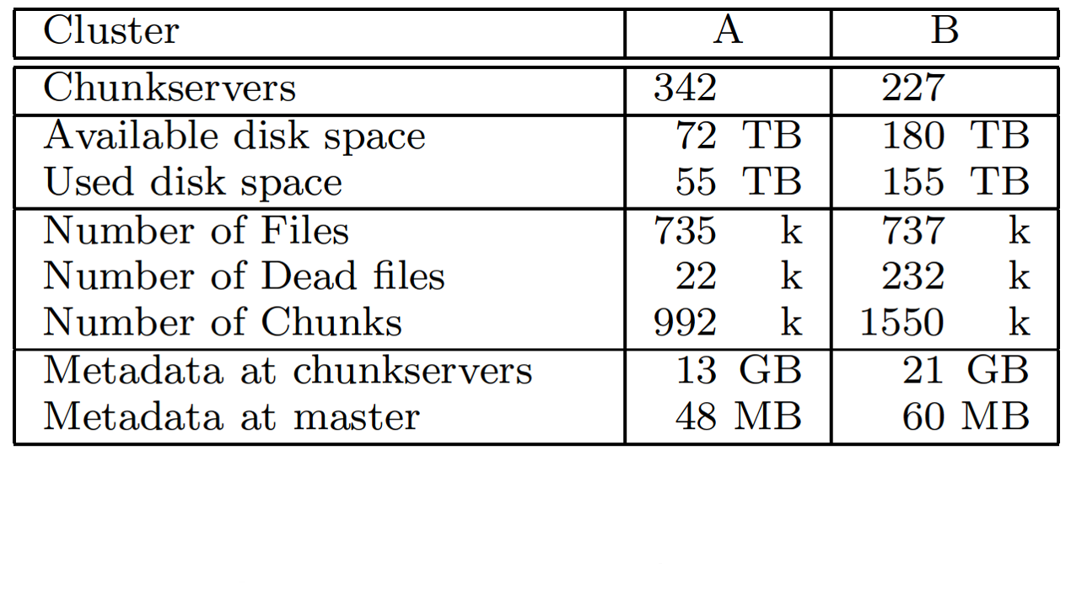
Sample Data
Figure 1-7: Characteristics of two GFS Clusters

Slide 37
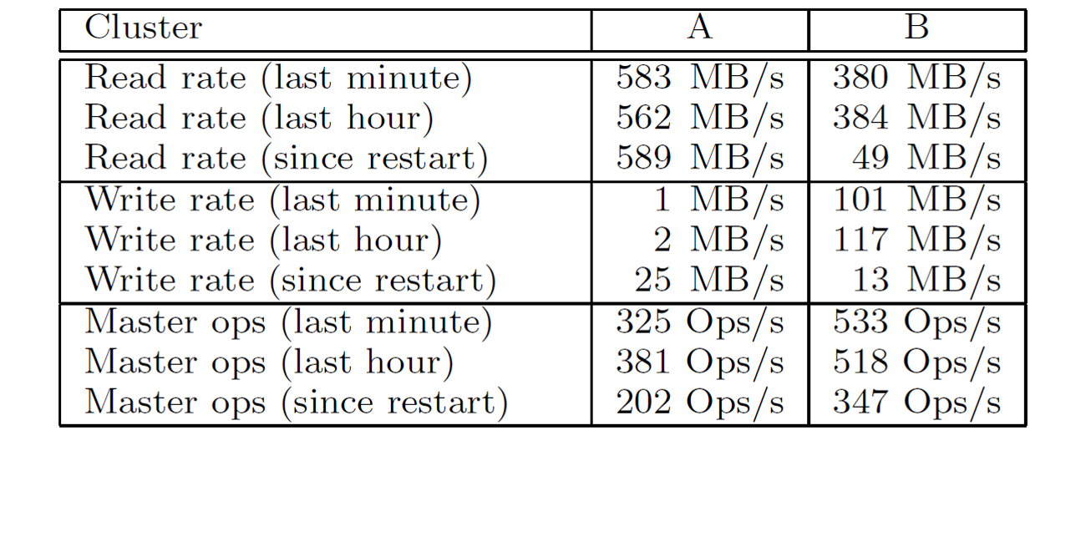
Sample Data…
Figure 1-8: Performance Metrics of two GFS Clusters

Slide 38
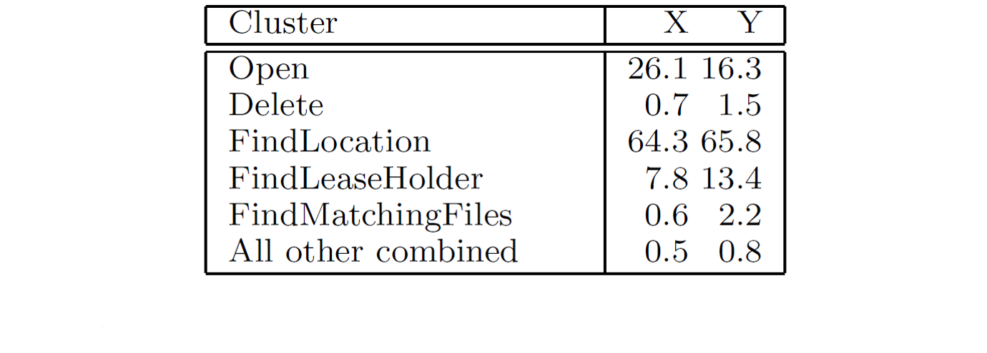
Sample Data…
Figure 1-9: Master Requests breakdown by Type (%)

Slide 39
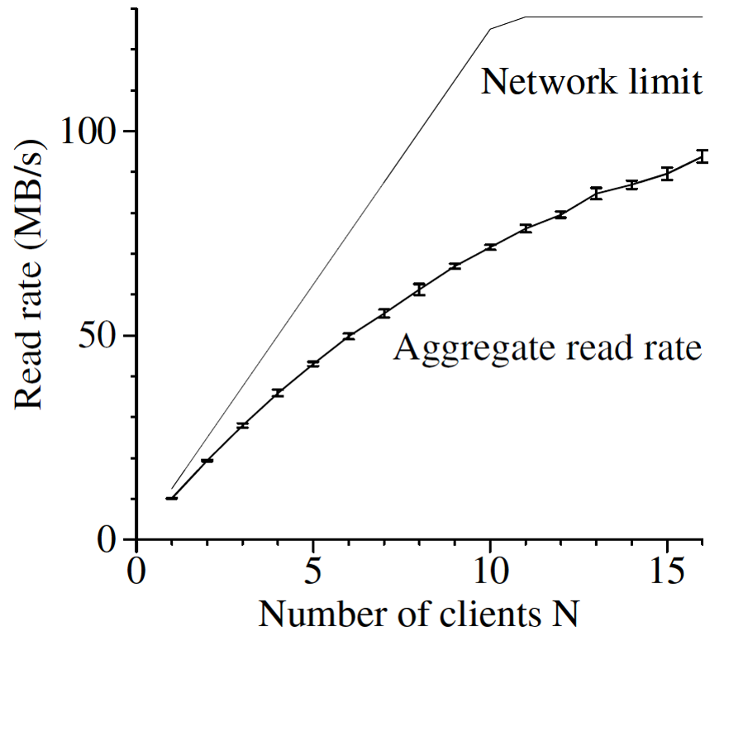
Sample Data…
Figure 1-10: Reads

Slide 40
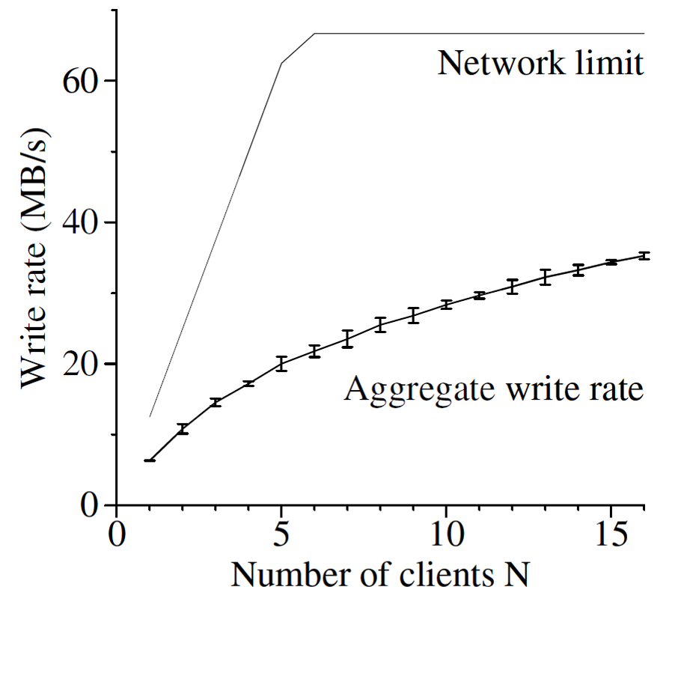
Sample Data…
Figure 1-11: Writes

Slide 41
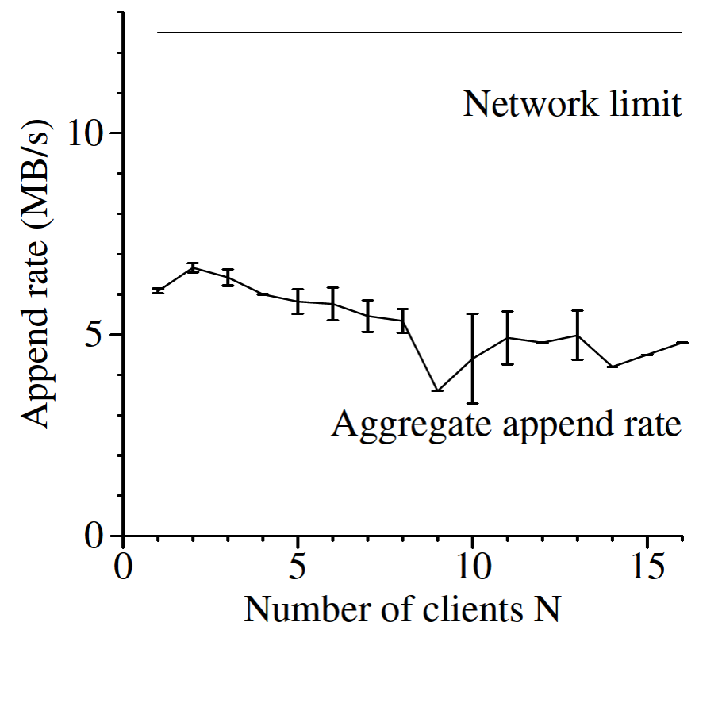
Sample Data…
(per a single file)
Figure 1-12: Record Appends

Slide 42
Recovery Time
Experiment: killed 1 Chunkserver:
  Clonings limited to 40% of the chunkservers and 50 Mbps each to limit impact on applications.
  All chunks restored in 23.2 min.
Experiment: killed 2 Chunkservers:
  266 of 16,000 chunks reduced to single replica.
  Higher priority re-replication for these chunks.
  Achieved 2x replication within 2 min.

Slide 43
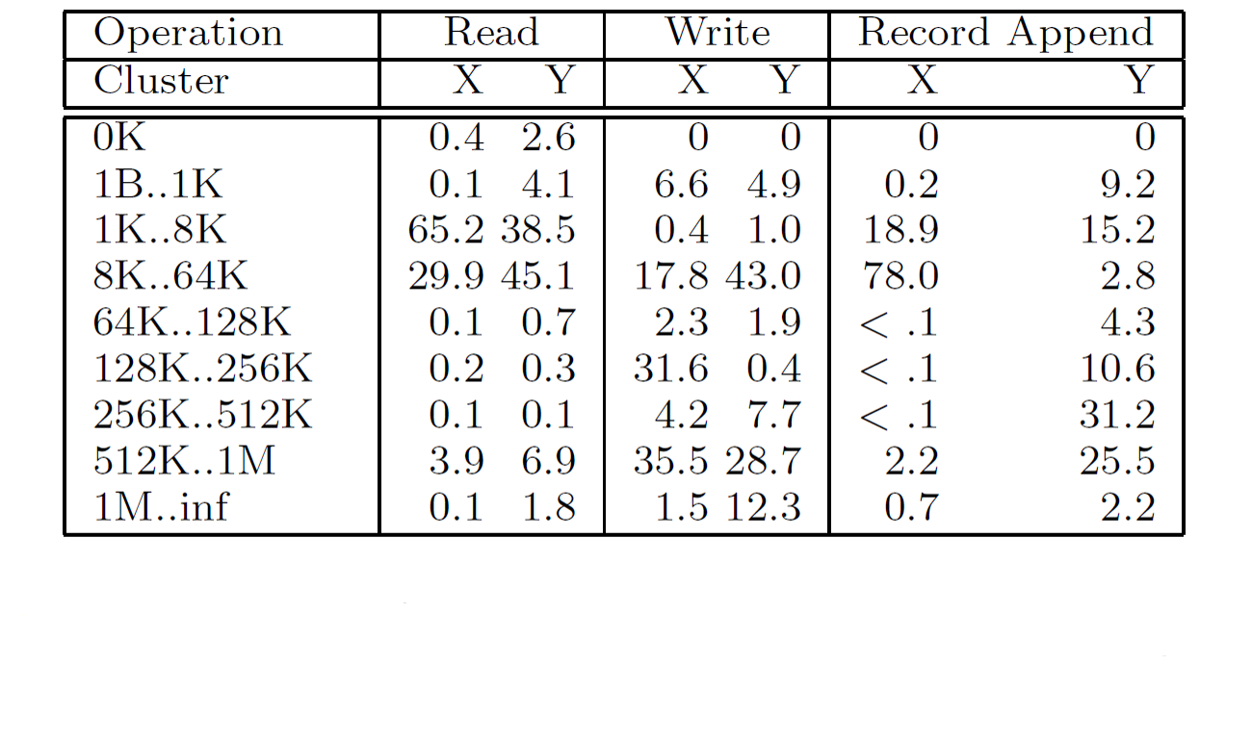
Sample Data…
Figure 1-13: Operations Breakdown by Size (%): For Reads, the size is the amount of data actually read and transferred, rather then the amount requested.

Slide 44
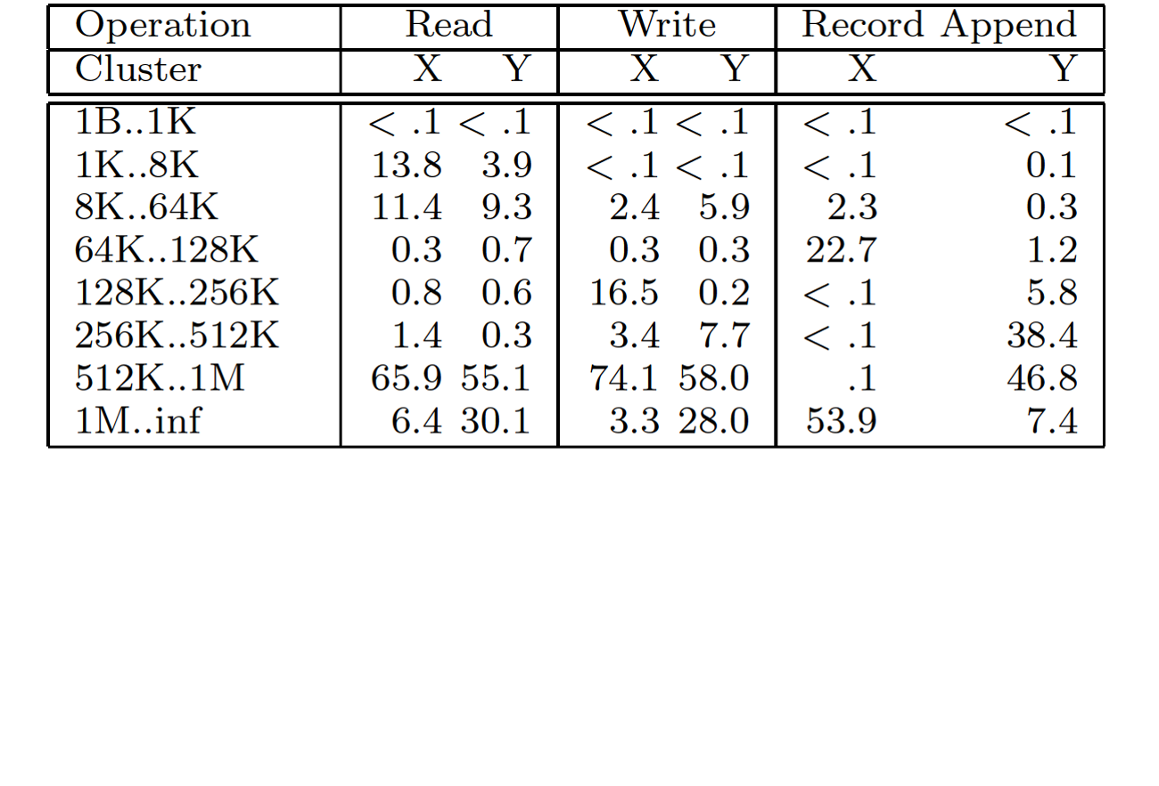
Sample Data…
Figure 1-14: Bytes transferred breakdown by Operation Size (%): For Reads, the size is the amount of data actually read and transferred, rather then the amount requested. The two may differ if there is an attempt to read beyond eof, not uncommon.

Slide 45
GFS: Summary
Success: used actively by Google to support search service and other applications:
  Availability and recoverability on cheap hardware.
  High throughput by decoupling control and data.
  Supports massive data sets and concurrent appends.
Semantics not transparent to apps:
  Must verify file contents to avoid inconsistent regions, repeated appends (at-least-once semantics).
Performance not good for all apps:
  Assumes read-once, write-once workload (no client caching!).

Slide 46
Next Week……
Logical Clocks & Synchronization
Distributed Lookup Services & Dynamic Hash Tables (DHTs)
Assessed Lab Exercise II
Group Project Discussions

